Slide 1
Retail Segmentation with h2o

Slide 2
Initial steps
Create the project
Add the packages
Set the repository reference date
Set the debug level
Add the data folder and copy the raw data
Quick test running master.R

Slide 3
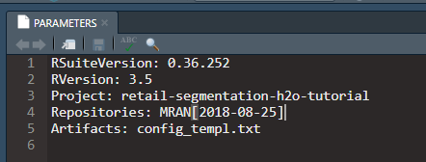
PARAMETERS
Change the MRAN date

Slide 4

config.txt
Set the log level to DEBUG

Slide 5
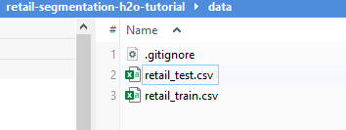
Add data files

Slide 6
Run master.R
We run the scripts from the terminal

Slide 7
Next steps
Package
  Add imports to DESCRIPTION
  Add imports to packages_import.R
  Add 1st script find_best_model.R
Project
  add 1st script build_p2b_nosegmentation_model.R
Terminal
  Install dependencies and build project
  Run script

Slide 8

terminal: Install and build
Install dependencies
Build project

Slide 9
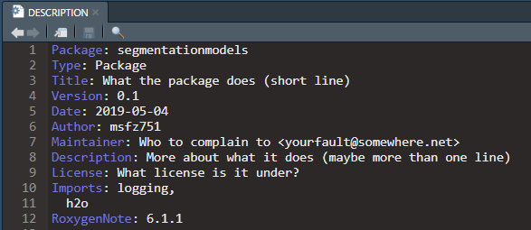
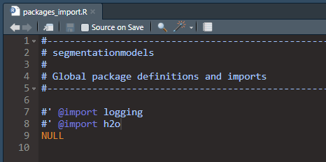
Add package h2o

Slide 10
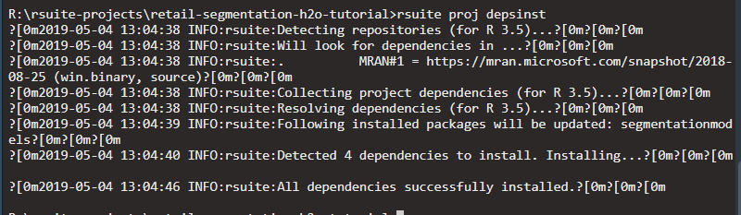
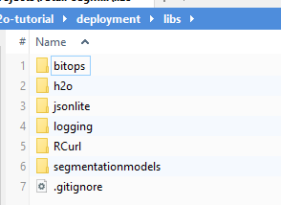
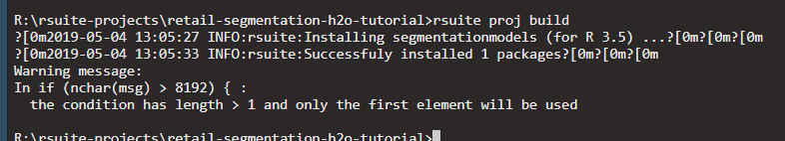
terminal: Install dependencies and build project

Slide 11
project: Add the first script to the project
build_p2b_nosegmentation_model.R

Slide 12
package: Add 1st script - find best model
find_best_model.R

Slide 13
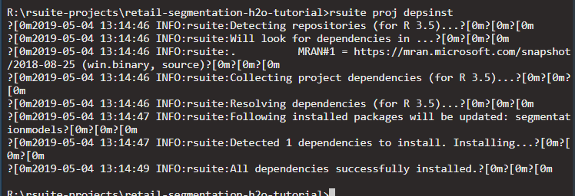
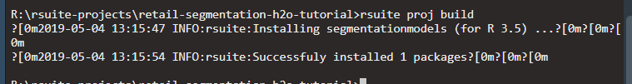
terminal: Install dependencies and build project

Slide 14
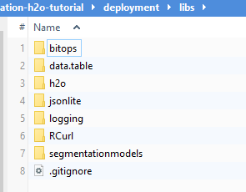
new packages have been added

Slide 15
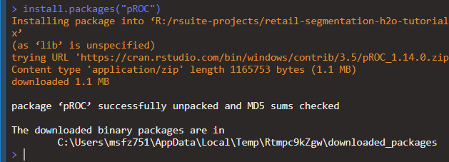
terminal: Run the no-segmentation model
It will run h2o but will stop on error because the package pROC is missing
Install pROC outside the project (global) because pROC is called by the project not the package

Slide 16
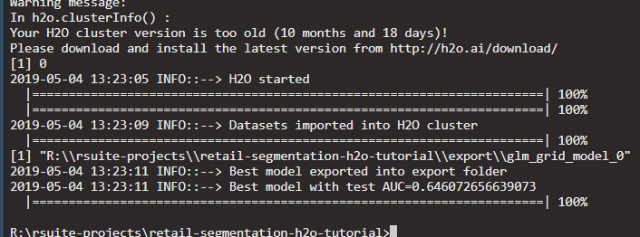
terminal: Run the same model again ...
No it runs h2o and rPROC

Slide 17
Next steps
Package
  Add 2nd script build_segmentation_models.R
  Add 3rd script predict_segmentation_models.R
Project
  add 2nd script build_p2b_nosegmentation_local_models.R
Terminal
  Install dependencies and build project
  Run script R/build_p2b_nosegmentation_local_models.R

Slide 18
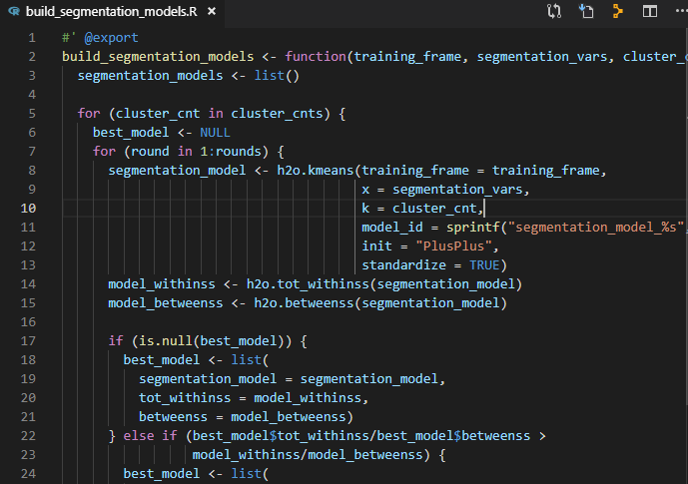
package: Add the 2nd script - build models

Slide 19
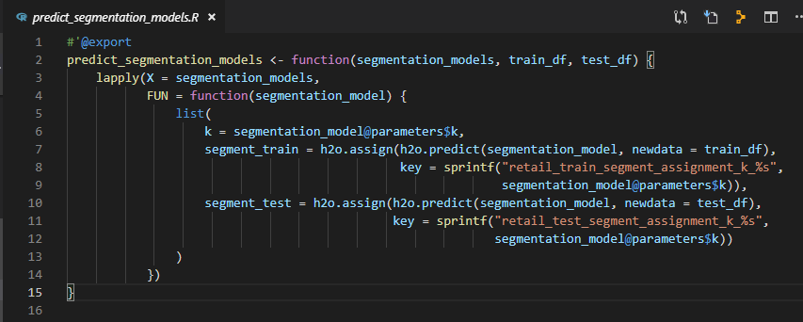
package: Add the 3rd script - prediction

Slide 20
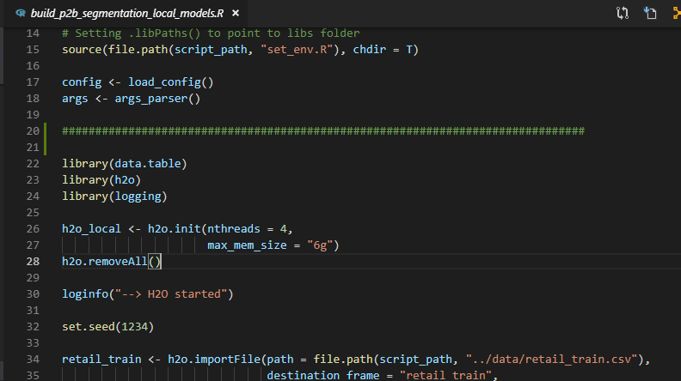
project: Add script for segmentation of local models

Slide 21
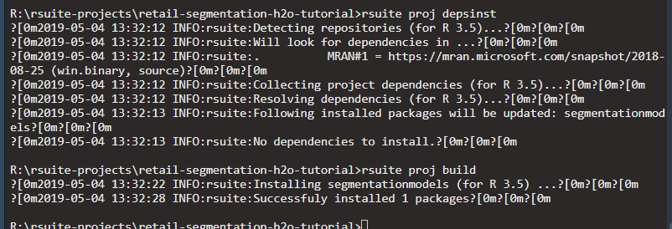
terminal: install dependencies and build project
the new package scripts will be added

Slide 22
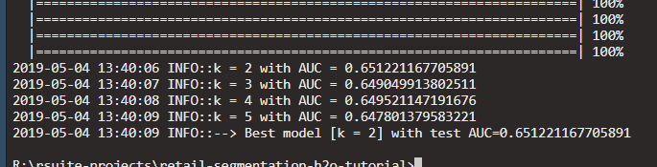
terminal: Run segmentation for local models
Results from h2o and pROC

Slide 23
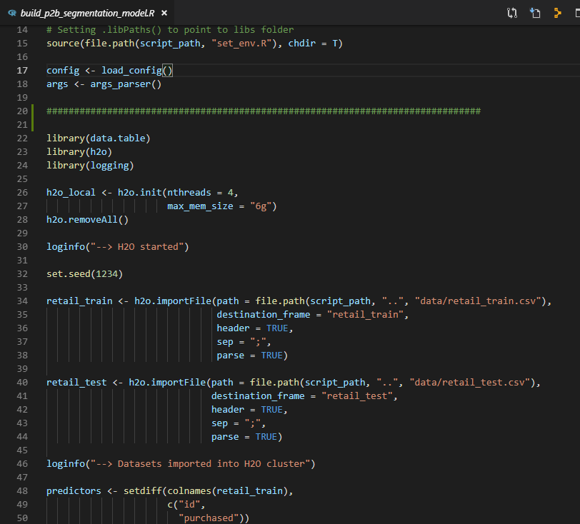
project: Add script for segmentation of standard models

Slide 24
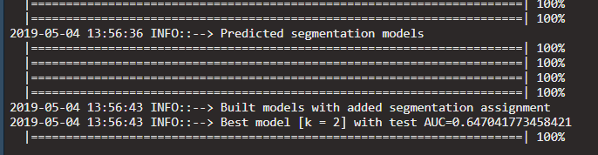
terminal: Run the standard models
In this case, we don’t need to install dependencies or build the project because we didn’t make any changes on the package, only on the project.

Slide 25
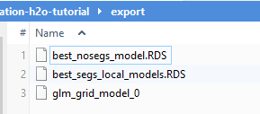
Observe an export folder has been created
These are the outputs of the scripts

Slide 26
Next steps
Package
  None
Project
  add 4th script compare_models.R
Terminal
  Run script R/compare_models.R

Slide 27
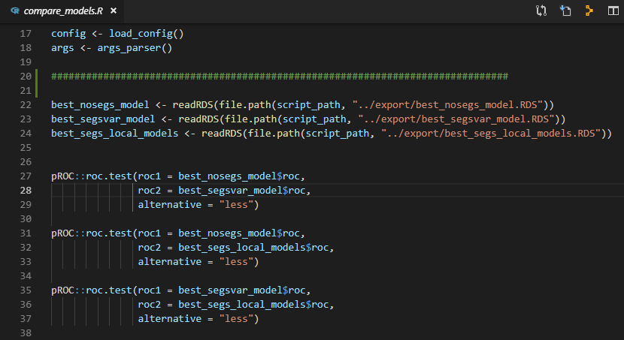
project: add the last script for model comparison

Slide 28
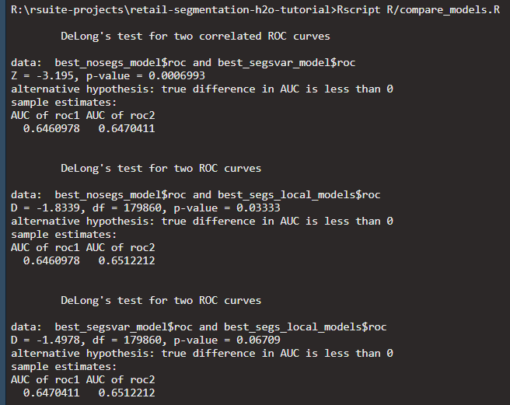
terminal: Run model comparison

